Slide 1

MICROPROCESSOR:
A REVOLUTION TO COMPUTER
TECHNOLOGY

Slide 2

Table of Contents
Introduction
Types
InventionꢀofꢀMicroprocessors
Differentꢀtypesꢀofꢀ
Microprocessors
Why?
Working
UseꢀandꢀAdvantagesꢀofꢀ
Microprocessors
Designꢀandꢀconstituentsꢀofꢀaꢀ
processor

Slide 3

Table of Contents
Moore’s Law
Cores
BenefitsꢀandꢀImpendingꢀofꢀ
Moore’sꢀlaw
CoreꢀinꢀaꢀCPUꢀandꢀtypesꢀofꢀ
cores
Conclusion
Conclusionꢀfromꢀtheꢀtopicsꢀ
discussed

Slide 4

01
INTRODUCTION

Slide 5

Microprocessor :
Brain of Computer
Microprocessorsꢀareꢀfirstꢀinventedꢀbyꢀintelꢀcompanyꢀinꢀ1971.ꢀTheseꢀareꢀusedꢀinꢀanꢀareaꢀofꢀ
requirementꢀ thatꢀ requiresꢀ aꢀ sortꢀ ofꢀ processing.ꢀ Itꢀ takesꢀ controlꢀ overꢀ eachꢀ partꢀ ofꢀ theꢀ
functionꢀinꢀcomputers.
Theyꢀcontainꢀanꢀalgorithmꢀandꢀworkꢀaccordingꢀtoꢀtheꢀinstructionsꢀgiven.
ComponentsꢀofꢀMicroprocessorꢀare:
● ALU
● REGISTERS
● CONTROL UNIT
Theseꢀareꢀfurtherꢀconnectedꢀtoꢀinput,ꢀmemoryꢀunitꢀandꢀoutputꢀdevices.

Slide 6
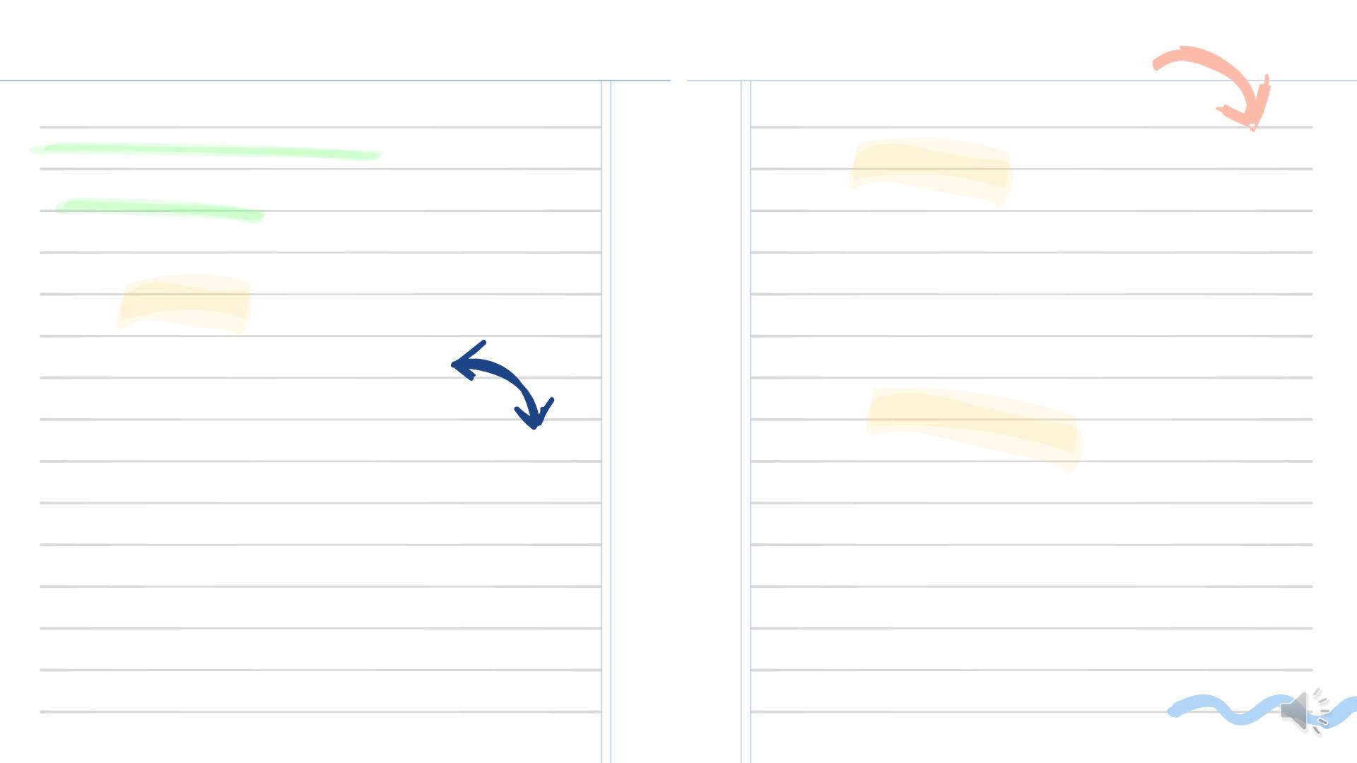
Components ofꢀ
Microprocessor:
Register
Theseꢀ areꢀ theꢀ temperoryꢀ
dataꢀ storageꢀ locationsꢀ ,theyꢀ
directꢀ toꢀ theꢀ locationꢀ whereꢀ
dataꢀisꢀstored.ꢀ
ALU
Allꢀtheꢀarithmeticꢀandꢀlogicalꢀ
calculationsꢀ onꢀ theꢀ dataꢀ areꢀ
doneꢀ byꢀ theꢀ processorꢀ
accordingꢀtoꢀtheꢀinputꢀgiven.ꢀ
Control Unit
Itꢀdictatesꢀhowꢀtheꢀinternalꢀmemoryꢀofꢀ
theꢀcomputerꢀshouldꢀrespondꢀtoꢀtheꢀ
givenꢀinstructionsꢀandꢀcontrolsꢀtheꢀflowꢀ
ofꢀdataꢀbetweenꢀtheꢀmicroprocessorꢀ
andꢀtheꢀsystem.ꢀ

Slide 7
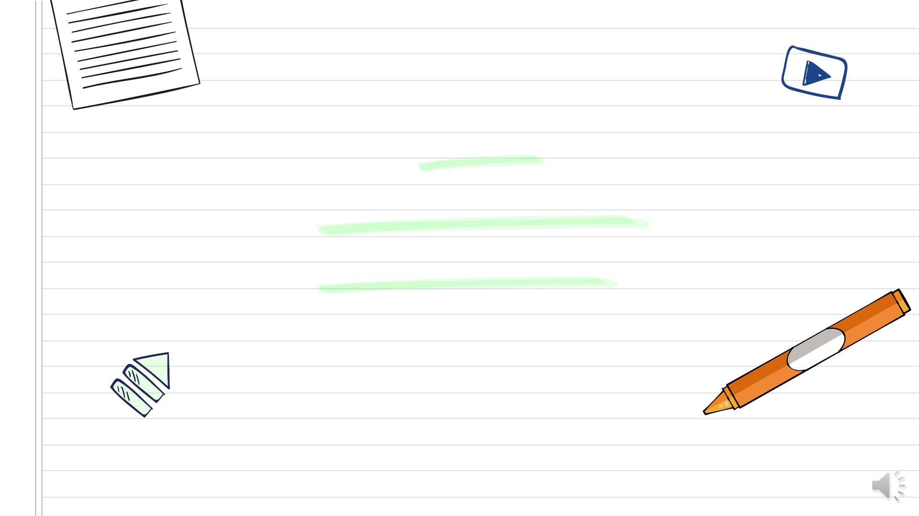
02
WHY WE USE
MICROPROCESSOR?

Slide 8

Transmitter,Reciever and Interpreter:
Why we use these chip-like processors?
●
●
●
●
Aꢀmicroprocessorꢀtransmits,ꢀrecievesꢀandꢀinterpretsꢀtheꢀdataꢀneededꢀforꢀtheꢀdevice.
Theseꢀprocessorsꢀexplicatesꢀtheꢀinputꢀandꢀperformsꢀtheꢀprogramsꢀaccordinglyꢀandꢀgivesꢀusꢀtheꢀoutput.
Itꢀinvolvesꢀ3ꢀstepsꢀFetch,ꢀDecodeꢀandꢀexecution
First,ꢀitꢀfetchesꢀtheꢀinformationꢀ,instructionsꢀareꢀobtainedꢀfromꢀmemoryꢀandꢀthenꢀperformsꢀanꢀaccurateꢀ
operation.
●
AdvantagesꢀofꢀMicroprocessor:
●
●
●
●
CapableꢀofꢀdoingꢀMulti-tasksꢀatꢀaꢀveryꢀshortꢀperiodꢀofꢀtime.
Importantꢀadvantageꢀisꢀit’sꢀspeed,ꢀwithꢀ3Hzꢀofꢀspeedꢀitꢀcanꢀperformꢀ3ꢀbillionꢀtasksꢀperꢀsecond.ꢀ
Theyꢀconsumeꢀlessꢀpowerꢀwhichꢀmakesꢀthemꢀefficient.
Theyꢀareꢀportable,ꢀversatileꢀandꢀreliable.

Slide 9
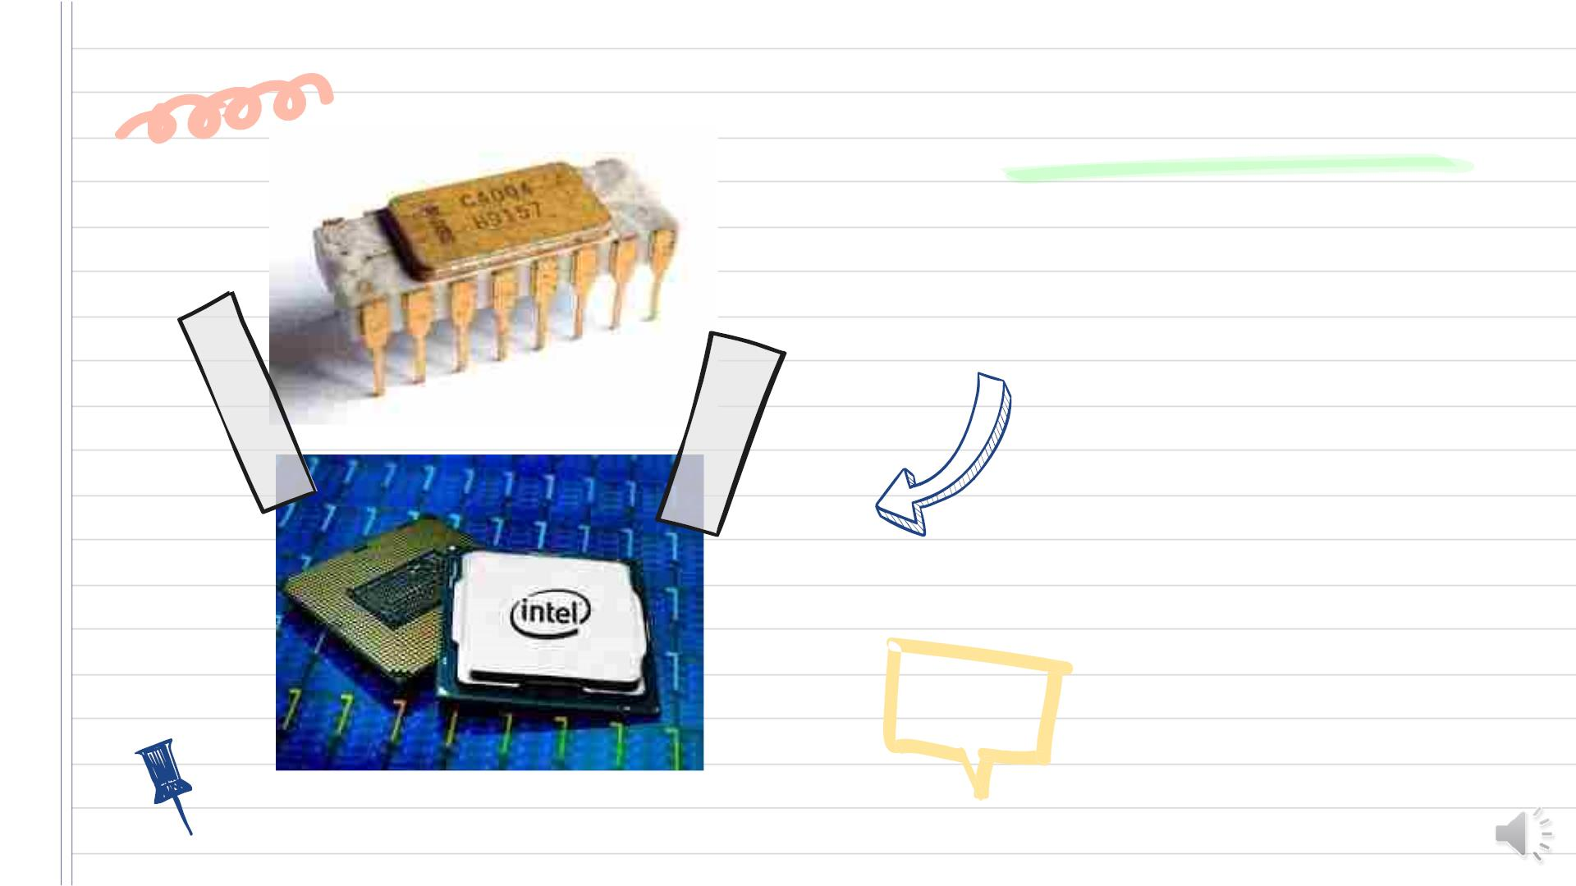
First and latest
microprocessors:
First picture is the
intel 4004 which
was invented in
the year 1971.
Second picture is
the latest i9
microprocessor
by the same
company intel.ꢀ

Slide 10

03
TYPES OF
MICROPROCESSOR:

Slide 11

Different types of
Microprocessors:
Superscalar
Itꢀ isꢀ capableꢀ ofꢀ implementingꢀ instructionꢀ
levelꢀ parallelism,ꢀ alsoꢀ executesꢀ multipleꢀ
instructionsꢀ perꢀ clockꢀ cycle.ꢀ Resultingꢀ inꢀ
thatꢀtheseꢀmicroprocessorsꢀareꢀveryꢀfast.
CISC
Complexꢀ Instructionꢀ Setꢀ Computerꢀ executesꢀ
singleꢀinstructionsꢀwithꢀlow-levelꢀoperations.ꢀ
Theseꢀ loadꢀ memoryꢀ andꢀ complexꢀ
computations.
API
Applicationꢀ Specificꢀ Integratedꢀ Circuitsꢀ areꢀ
forꢀspecificꢀpurposesꢀonly.ꢀTheyꢀareꢀmodernꢀ
andꢀentireꢀmicroprocessorꢀisꢀinꢀsingleꢀchip.
RISC
Reducedꢀ Instructionꢀ Setꢀ computerꢀ workꢀ
withꢀfewerꢀinstructionꢀcycles.ꢀThisꢀtheꢀmostꢀ
commonlyꢀusedꢀprocessor.
Bit-Slice Microprocessor
BSMꢀisꢀaꢀspecialꢀtypeꢀofꢀmicroprocessorꢀ
whoseꢀmainꢀpurposeꢀisꢀtoꢀformꢀaꢀ
microprocessorꢀofꢀdesiredꢀwordꢀsizeꢀbyꢀ
combiningꢀidenticalꢀBSMs.ꢀ

Slide 12

Graphic Processor
Input/Output
GraphicsꢀProcessorsꢀareꢀspeciallyꢀ
designedꢀprocessorsꢀforꢀgraphics.ꢀItꢀisꢀ
designedꢀmostlyꢀforꢀsuchꢀheavyꢀ
multimediaꢀusesꢀasꢀgamesꢀandꢀ
movies.
Itꢀ isꢀ usedꢀ toꢀ controlꢀ IOꢀ devices.ꢀ Oneꢀ ofꢀ
theꢀ exampleꢀ isꢀ DMAꢀ controlꢀ andꢀ theseꢀ
typesꢀ ofꢀ processorsꢀ haveꢀ theirꢀ ownꢀ
memory.
Digital Signal Processor
Coprocessor
Digitalꢀ Signalꢀ processorsꢀ requireꢀ termꢀ
memory,ꢀ input/outputꢀ memoryꢀ andꢀ
programꢀ memory.ꢀ Mainlyꢀ usedꢀ forꢀ
processingꢀanalogꢀtoꢀdigitalꢀsignals.
Theseꢀ areꢀ usedꢀ toꢀ handleꢀ practicalꢀ
operationsꢀinꢀaꢀmuchꢀfasterꢀwayꢀthanꢀtheꢀ
normalꢀprocessor.ꢀOneꢀofꢀsuchꢀprocessorꢀ
isꢀ8007processor.

Slide 13

04
WORKING OF
MICROPROCESSOR:

Slide 14

Design and Constituents:
Design and constituents of ALU, Registers and Control Unit:
●
●
●
AsꢀweꢀknowꢀMicroprocessorꢀcontrolsꢀallꢀtheꢀpartsꢀofꢀcomputerꢀbasisꢀofꢀtheꢀꢀinstructionsꢀgivenꢀbyꢀtheꢀinputꢀ
dataꢀtoꢀtheꢀcomputer.
DesignꢀofꢀALUꢀfromꢀtheꢀnameꢀitselfꢀweꢀcanꢀunderstandꢀthatꢀitꢀisꢀfunctionedꢀasꢀtoꢀoperateꢀmathematicalꢀ
andꢀlogicalꢀoperations.
RegisterꢀarraysꢀconsistꢀofꢀregistersꢀidentifiedꢀbyꢀlettersꢀlikeꢀB,ꢀC,ꢀD,ꢀE,ꢀH,ꢀLꢀandꢀaccumulatorꢀandꢀtheꢀcontrolꢀ
unitꢀcontrolsꢀtheꢀflowꢀofꢀdataꢀandꢀinputꢀinstructions
Working of Microprocessor:
●
●
Weꢀhavꢀseenꢀinꢀtheꢀpreviousꢀslidesꢀthatꢀtheꢀprocessorꢀincludesꢀ3ꢀstepsꢀFetch,ꢀDecodeꢀandꢀexecute.
Theseꢀareꢀnothingꢀbutꢀworkingꢀofꢀprocessors,ꢀInitiallyꢀinstructionsꢀareꢀstoredꢀinꢀtheꢀmemoryꢀofꢀtheꢀ
computer,ꢀnextꢀitꢀfetchesꢀtheꢀinstructionsꢀandꢀdecodesꢀitꢀinꢀmemoryꢀandꢀfinallyꢀexecutesꢀtheꢀ
output.
●
●
Laterꢀonꢀitꢀresultsꢀtheꢀbinaryꢀoutputꢀ,thenꢀitꢀisꢀpassedꢀtoꢀALUꢀwhereꢀarithmeticꢀoperationsꢀtakesꢀ
placaꢀandꢀ1’sꢀandꢀ0’sꢀareꢀconvertedꢀuserꢀrequiredꢀoutput.
TermsꢀwhichꢀareꢀgenerallyꢀusedꢀinꢀMicroprocessorꢀareꢀInstructionꢀset,ꢀBandwidth,Clockspeed,ꢀ
CacheꢀMemory,ꢀBus,ꢀWordꢀLengthꢀandꢀDataꢀtypes.

Slide 15

Common Terms in
Microprocessor:
q InstructionꢀSet:ꢀItꢀgivesꢀinstructionsꢀtoꢀtheꢀprocessorꢀandꢀconvertsꢀtheꢀinputꢀtoꢀBinary.
q BandꢀWidth:ꢀNumberꢀofꢀbitsꢀprocessedꢀinꢀaꢀsingleꢀstepꢀisꢀnothingꢀbutꢀwidthꢀofꢀbytes.ꢀ
q ClockꢀSpeed:ꢀItꢀdecidesꢀnumberꢀofꢀoperationsꢀtheꢀprocessorꢀcanꢀperformꢀperꢀsecond.
q CacheꢀMemory:ꢀRAMꢀisꢀintegratedꢀinꢀcacheꢀmemoryꢀso,ꢀitꢀcanꢀaccessꢀdataꢀfaster.
q Bus:ꢀItꢀisꢀsetꢀofꢀconductorsꢀwhichꢀintendꢀtoꢀtransmitꢀdata.ꢀAddressingꢀandꢀcontrollingꢀtheꢀ
information.ꢀThereꢀareꢀData,ꢀControl,ꢀandꢀAddressꢀBusꢀtoꢀaccessꢀtheꢀdata.
q Wordꢀlength:ꢀLengthꢀrangesꢀfromꢀ4ꢀtoꢀ64ꢀbitsꢀbasedꢀonꢀtheꢀinternalꢀdataꢀbus,ꢀregistersꢀandꢀ
ALU.
q Dataꢀtypes:ꢀConvertingꢀtheꢀinputꢀintoꢀASCII,ꢀBinaryꢀorꢀBCDꢀetc.

Slide 16

05
CORE OF A
MICROPROCESSOR

Slide 17
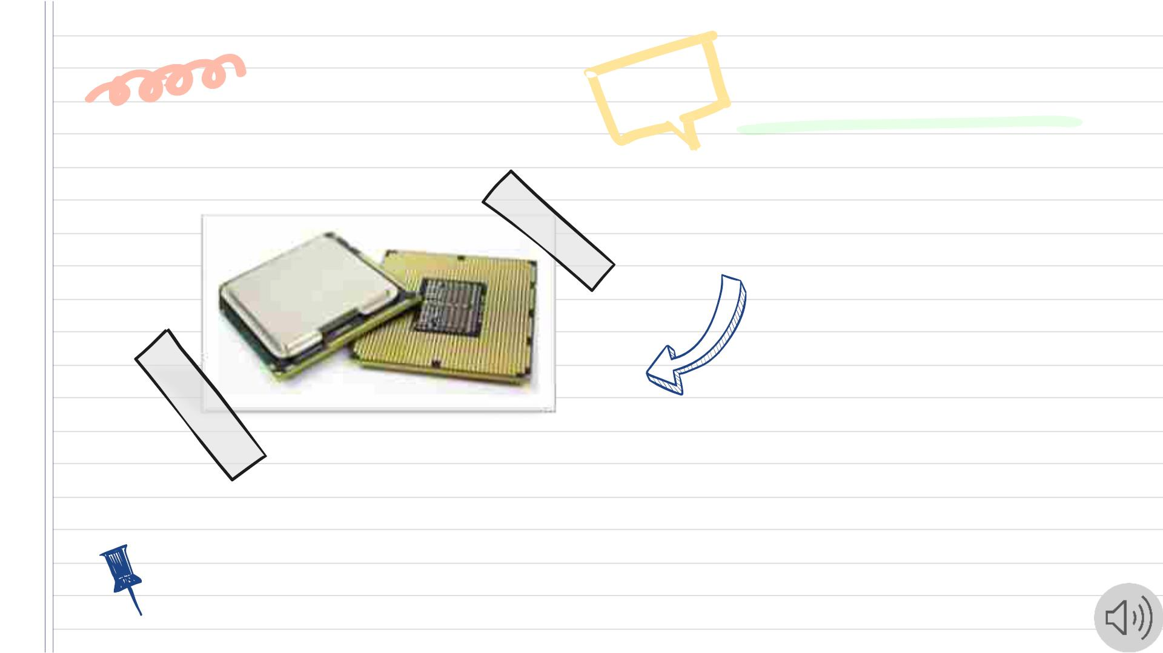
Core in a CPU:
q A Core gets guidelines and
performs computation or
activities. So, a CPU can
have multiple cores.
These cores contain a single
or multiple processors and
they perform their tasks
independent.
q According to the cores in
a computers it depends on
how efficient and faster
the computer is working.ꢀ

Slide 18
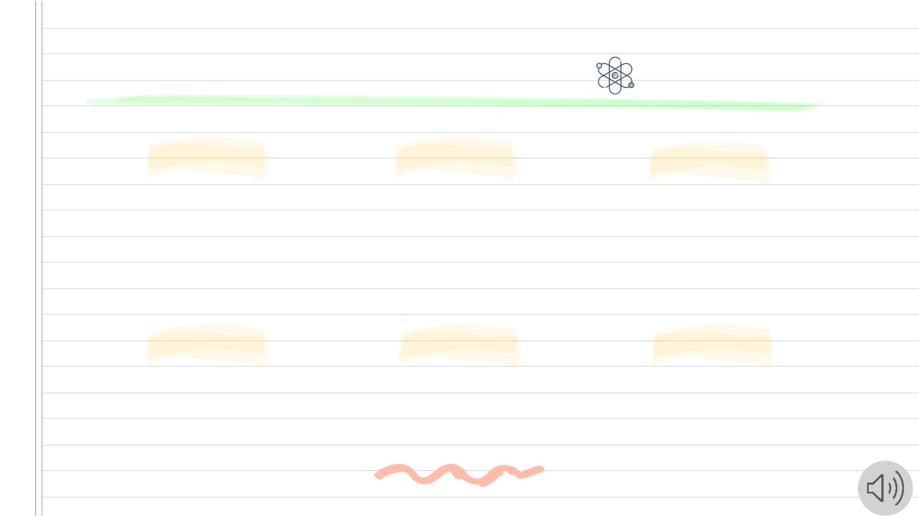
Types of Cores:
Single
Dual
Quad
Aꢀprocessorꢀwithꢀsingleꢀ
core.ꢀItꢀisꢀtheꢀfirstꢀandꢀ
oldestꢀtypeꢀofꢀCPUꢀ
core.
Aꢀprocessorꢀwithꢀtwoꢀcores.ꢀ Aꢀprocessorꢀwithꢀfourꢀcores.ꢀItꢀisꢀ
ItꢀisꢀaꢀsingleꢀCPUꢀcoreꢀthatꢀ similarꢀtoꢀdualꢀcoreꢀbut,ꢀhasꢀfourꢀ
canꢀfunctionꢀwithꢀdualꢀCPUꢀ
actingꢀ.
separateꢀprocessors.
Hexa
Octa
Deca
Aꢀprocessorꢀwithꢀsixꢀcores.ꢀItꢀ Aꢀprocessorꢀwithꢀeightꢀcores.ꢀ Aꢀprocessorꢀwithꢀtenꢀcores.ꢀItꢀcanꢀ
executeꢀandꢀmanageꢀaꢀtaskꢀrapidly.ꢀ
worksꢀrapidlyꢀthanꢀquad-coreꢀ
processores.
Itꢀcanꢀexecuteꢀaꢀtaskꢀ
effectivelyꢀandꢀefficiently. Decaꢀisꢀtheꢀsucesssfulꢀcoresꢀthanꢀ
comparedꢀtoꢀothers.

Slide 19

06
MOORE’S LAW:

Slide 20

Postulates and it’s
Advantages!
Moore'sꢀlawꢀstatesꢀthatꢀnumberꢀofꢀtransistorsꢀinꢀmicrochipꢀdoublesꢀeveryꢀtwoꢀyears,ꢀ
althoughꢀcostsꢀofꢀcomputersꢀisꢀhalved.
Asꢀtheꢀtimeꢀcontinuesꢀallꢀtransistorsꢀandꢀmicroprocessorsꢀbecameꢀsmallerꢀandꢀfasterꢀandꢀ
alsoꢀcheaper.
Benefits of Moore’s law are:
•ꢀComputing
•ꢀElectronic
•ꢀAllꢀsectorsꢀbenefit
Theꢀtransistorsꢀbecameꢀmoreꢀefficient,ꢀsmaller,ꢀfasterꢀandꢀcheaperꢀasꢀpartlyꢀbecauseꢀ
lowꢀlaborꢀcostsꢀandꢀdecreaseꢀinꢀprizesꢀofꢀsemiconductors.ꢀ

Slide 21
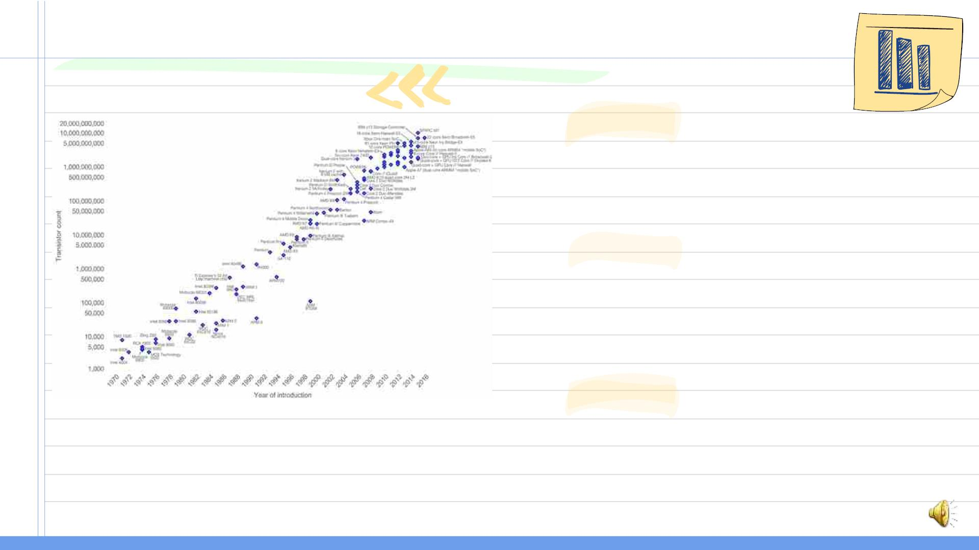
Graph of Impending Moore’s law:
Reason1
Scaleꢀ ofꢀ theꢀ chipꢀ componentꢀ isꢀ gettingꢀ reducedꢀ
everyꢀ yearꢀ whichꢀ willꢀ causeꢀ individualꢀ atomꢀ toꢀ getꢀ
closerꢀandꢀcloserꢀmakingꢀitꢀtechnicallyꢀhard.
Reason2
Inꢀ 2007ꢀ interviewꢀ Mooreꢀ heꢀ himselfꢀ statedꢀ thatꢀ itꢀ
willꢀ beꢀ difficultꢀ forꢀ anyꢀ materialꢀ toꢀ manufactureꢀ asꢀ
weꢀ areꢀ pushingꢀ everyꢀ elementꢀ togetherꢀ andꢀ atꢀ
someꢀpointꢀweꢀneedꢀtoꢀstopꢀmakingꢀthingsꢀsmaller.ꢀ
Reason
3
Asꢀ shownꢀ inꢀ theꢀ logarithmicꢀ graphꢀ ofꢀ theꢀ numberꢀ ofꢀ
transistorsꢀ onꢀ Intel'sꢀ processorsꢀ atꢀ theꢀ timeꢀ ofꢀ theirꢀ
introduction,ꢀhisꢀ“law”ꢀwasꢀbeingꢀobeyed.ꢀ
AsꢀtheꢀtimeꢀfliesꢀMoore’sꢀlawꢀwillꢀbeꢀreplacedꢀbyꢀ
Neven’sꢀlaw.

Slide 22
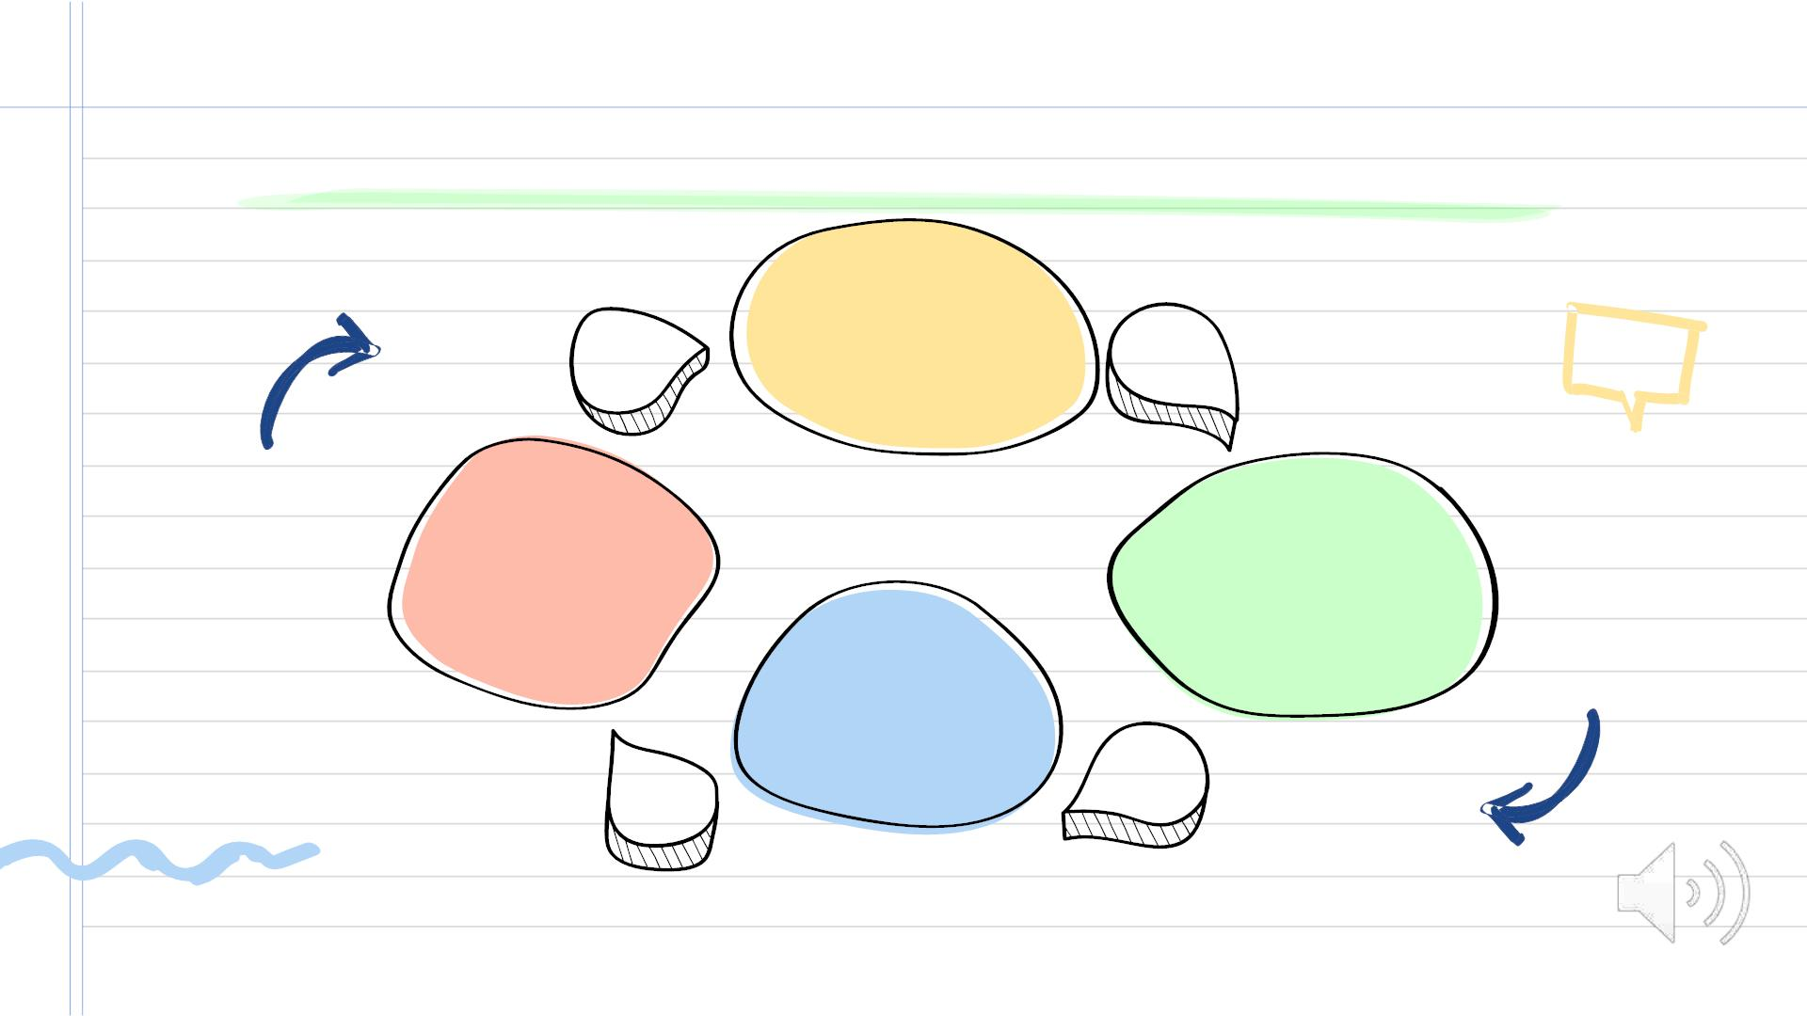
CONCLUSION
Everyꢀsectorꢀfromꢀ
high-techꢀtoꢀ
04
medicalꢀgotꢀ
benefittedꢀbyꢀ
microprocessor.
MICROPROCESSOR
Portable,ꢀversatile,ꢀ
cheapꢀandꢀmoreꢀ
efficient
Itꢀisꢀoneꢀofꢀtheꢀ
technologicalꢀ
innovationsꢀ!!
Revolutionalizedꢀ
theꢀfieldꢀofꢀ
digitalꢀ
technologies.
02
03

Slide 23
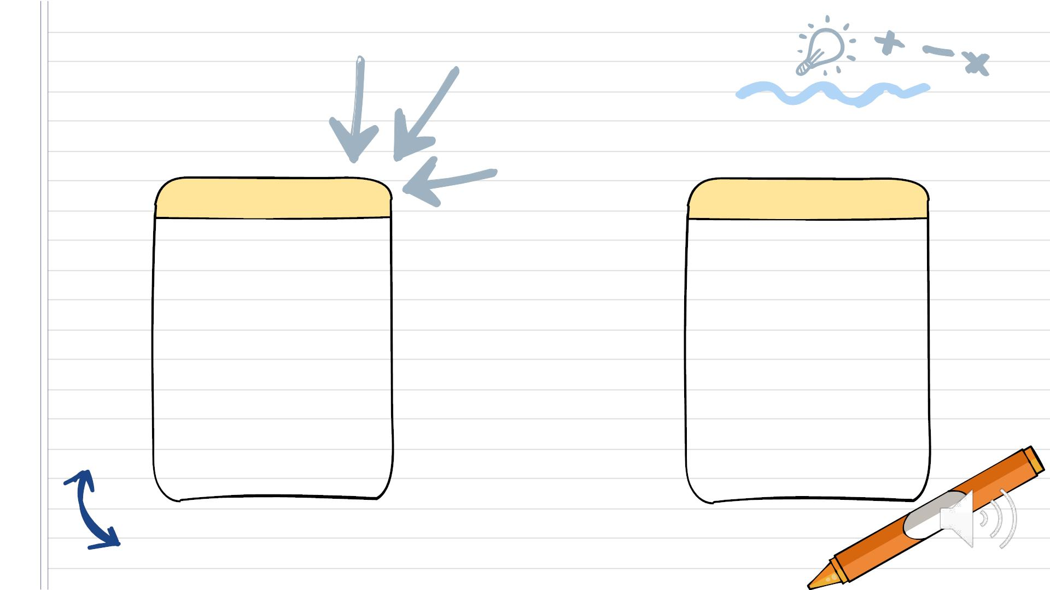
05
06
Therefore, Computers
with these processors,
have enough power to
compute many
Theꢀdevelopmentsꢀinꢀ
microprocessorsꢀsinceꢀ
theꢀyearꢀ1971ꢀisꢀ
tremendous.ꢀImprovingꢀ
it’sꢀarchitecture,ꢀspeed,ꢀ
lessꢀpowerꢀconsuming,ꢀ
accessingꢀmoreꢀmemoryꢀ
andꢀmakingꢀitꢀmoreꢀ
efficient.
business, industrial
and scientific tasks.
Invention of these
exceled the quick
calculation which
made them beyond
human reach

Slide 24
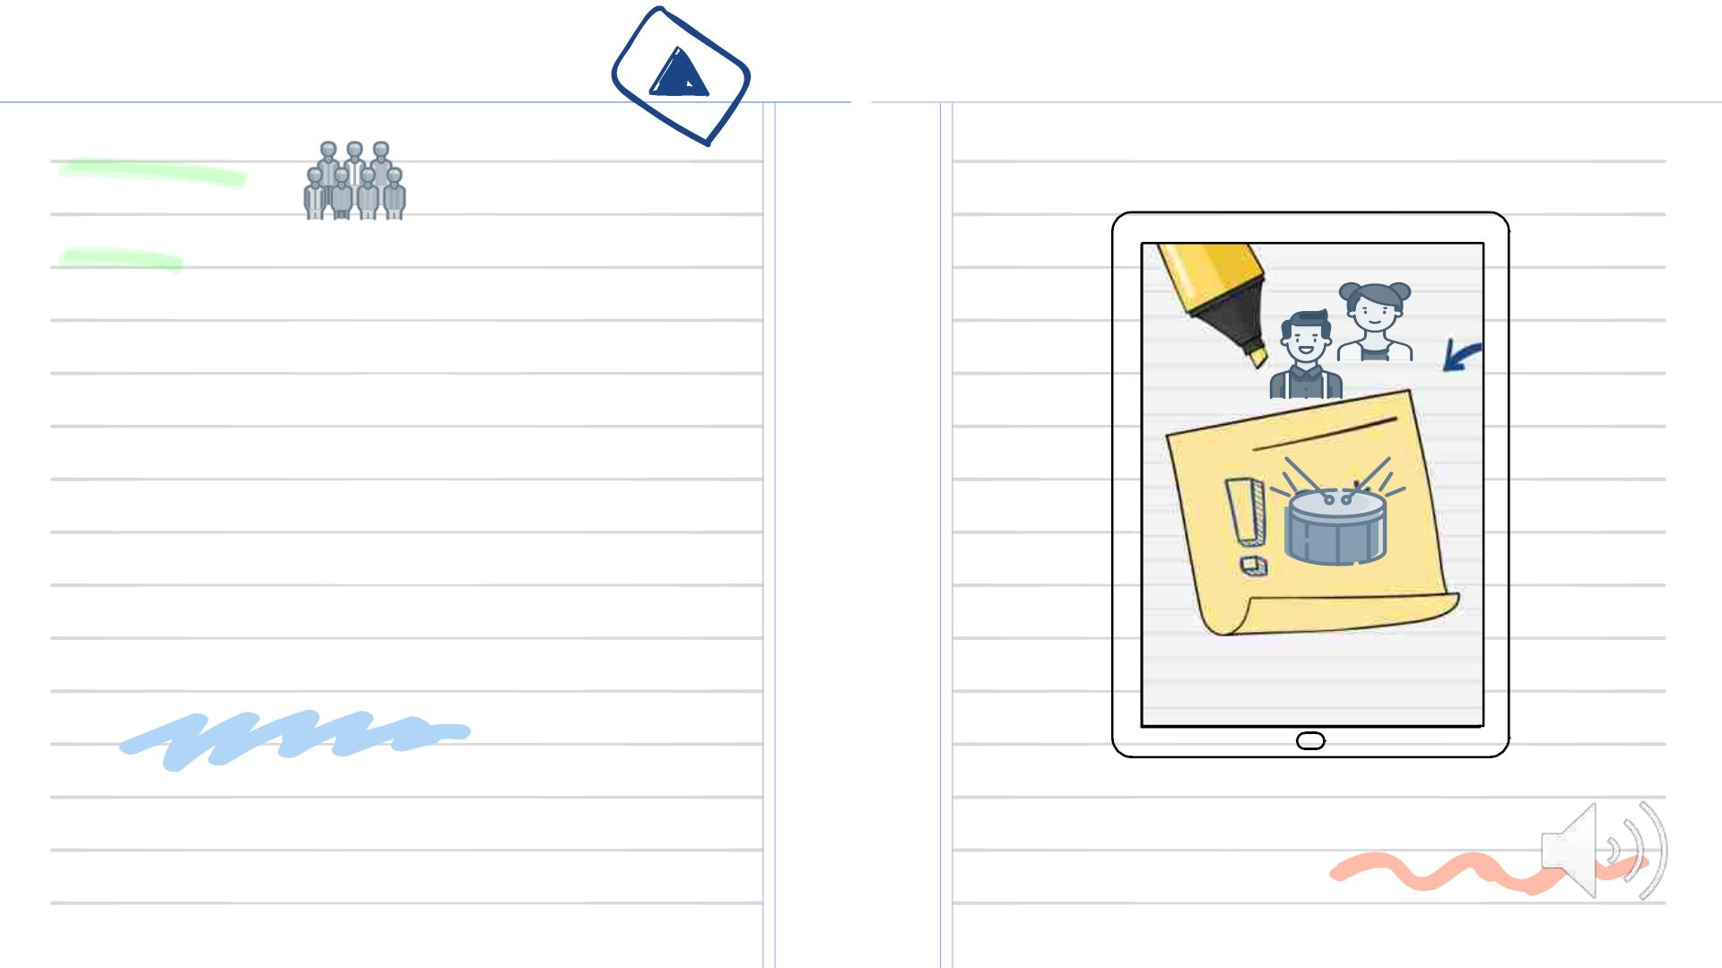
Team
Mates:
1) BANGARIꢀVIVEKRAJ
2) SAIꢀSARVAGNA
3) BOUDHIKꢀSHAJ
4) CꢀSAIꢀKRISHNAꢀKUMAR
5) CꢀSIRIꢀSANJAY
6) DꢀKOUSHIK
7) DEVESHꢀKUMAR
ꢀ

Slide 25

THANK YOU!

